Slide 1

RocksDB Overview and Architecture
Ruth Okoilu, Abhisha Bhattacharyya

Slide 2
Definition
RocksDB - an embeddable persistent key-value store for fast storage.
Key-value pair - a set of 2 linked data items.
Key - a unique identifier for some item of data.
Value - data identified or a pointer to the location of the data
Key-Value store - Simplest form of database storage. Can store pairs of key- value and retrieve data when a key is known.[12]
Not a distributed database so CAP theorem does not apply

Slide 3
Overview
NoSQL
No relational data model
Does not support SQL queries
Allows implementation of ACID transactions[8]
Notes:
Snapshots are used to implement multiversion concurrency control, which in turn enables us to implement ACID transactions within RocksDB.

Slide 4
LevelDB Architecture
Write requests from application comes to RAM and Txn log.
When full, the data is flushed to disk.
Periodic compaction is done on the data on disk.
Then for read request, the RAM and disk is checked.

Slide 5
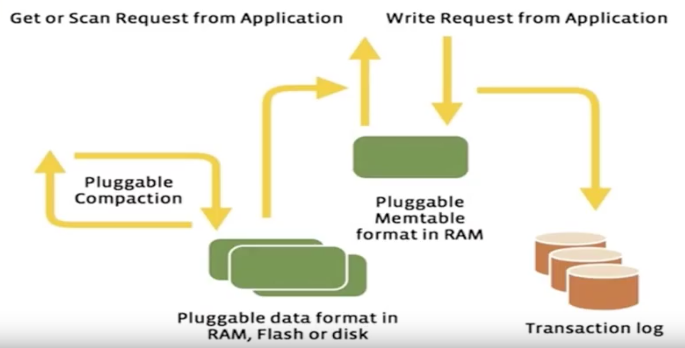
LevelDB Architecture
Notes:
Write requests from application comes to RAM and Txn log. When full, the data is flushed to disk. Periodic compaction is done on the data on disk. Then for read request, the RAM and disk is checked.
We use memtable so that we can have a memtable in RAM
Pluggable Compaction - when to flush data to disk

Slide 6
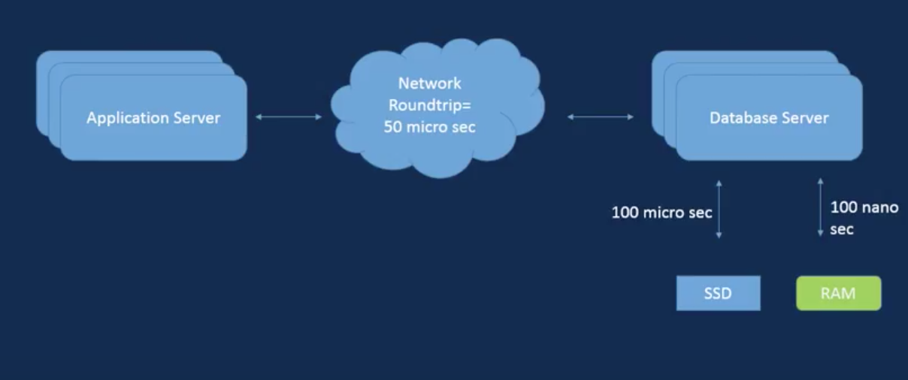
LevelDB Network Architecture
Notes:
Normal DB Network Architecture
Client - Server Architecture
Client = application server
Consists of app server db server connected by a network
Data is transferred between locally attached disks and database server

Slide 7
RocksDB - Modified LevelDB
Key-Value persistent storage
Embedded
Optimized for Fast storage: LevelDB write rate was very low ( 2MB/sec). RocksDB solves this by making database part of the application server
Implemented lots of concurrent operation
Server workload capabilities added.
Changed the level style compaction to universal compaction (similar to HBase style compaction). Universal compaction does a single compaction at the right time based on some algorithm as opposed to level by level compaction.
Introduced blooms are used for gets and scan requests
Notes:
RocksDB just like LevelDB has Key-Value persistent storage
Embedded but fixed the following limitations and Problems of LevelDB
2. No concurrent operations so they implemented lots of concurrent operations
The compaction operation is the way to reduce disk space usage by removing unused and old data from database or view index files.
RocksDB Changed the level style compaction to universal compaction (similar to HBase style compaction). Universal compaction does a single compaction at the right time based on some algorithm as opposed to level by level compaction.

Slide 8
RocksDB vs LevelDB
Below are some of the RocksDB features that are absent in LevelDB
Multi-thread compaction
Multi-thread memtable inserts
Column Families
Backup and Checkpoints
Merge Operators
Compaction Filters
Manual Compactions Run in Parallel with Automatic Compactions
More Compression Types: zlib, lz4, zstd
Delete files in range
Notes:
Some method called Multi-thread compaction instead of level by level
Changed the level style compaction to universal compaction (similar to HBase style compaction). Universal compaction does a single compaction at the right time based on some algorithm as opposed to level by level compaction.
To delete a range of keys:
You can issue a DeleteFilesInRange() to the range. The command will remove all SST files only containing keys in the range to delete.

Slide 9
More Features of RocksDB
RocksDB provides all of the features of LevelDB, plus:
Column families: Each key-value pair in RocksDB is associated with exactly one Column Family. If there is no Column Family specified, key-value pair is associated with Column Family "default". Column Families provide a way to logically partition the database [2].
Bloom filters: every file contains a Bloom filter, which is used to determine if the file may contain the key being searched for [2].
Statistics collection: DB Statistics provides cumulative stats over time giving an aggregated view across all operations [2].
Notes:
Column families are simply ways to group the key value pairs
For search, bloom filters (Read from slide)
Bloom - for getting data - search queries
There the concept of DB Statistics which (Read from slide)

Slide 10
More Features of RocksDB
Transactions: Transactions have a simple BEGIN/COMMIT/ROLLBACK API and allow applications to modify their data concurrently while letting RocksDB handle the conflict checking. RocksDB supports both pessimistic and optimistic concurrency control.[2]
Geospatial indexing: Spatial indexing is available in RocksDB under a name SpatialDB [4].
Notes:
Pessimistic mode - it has the concept of transactions - that allows Atomicity and enforces the ACID property
When using a TransactionDB, all keys that are written are locked internally by RocksDB to perform conflict detection. If a key cannot be locked, the operation will return an error. When the transaction is committed it is guaranteed to succeed as long as the database is able to be written to.
In the Optimistic mode conflicts can occur
It allow applications to modify their data concurrently while letting RocksDB handle the conflict checking
Optimistic Transactions do not take any locks when preparing writes. Instead, they rely on doing conflict-detection at commit time to validate that no other writers have modified the keys being written by the current transaction

Slide 11
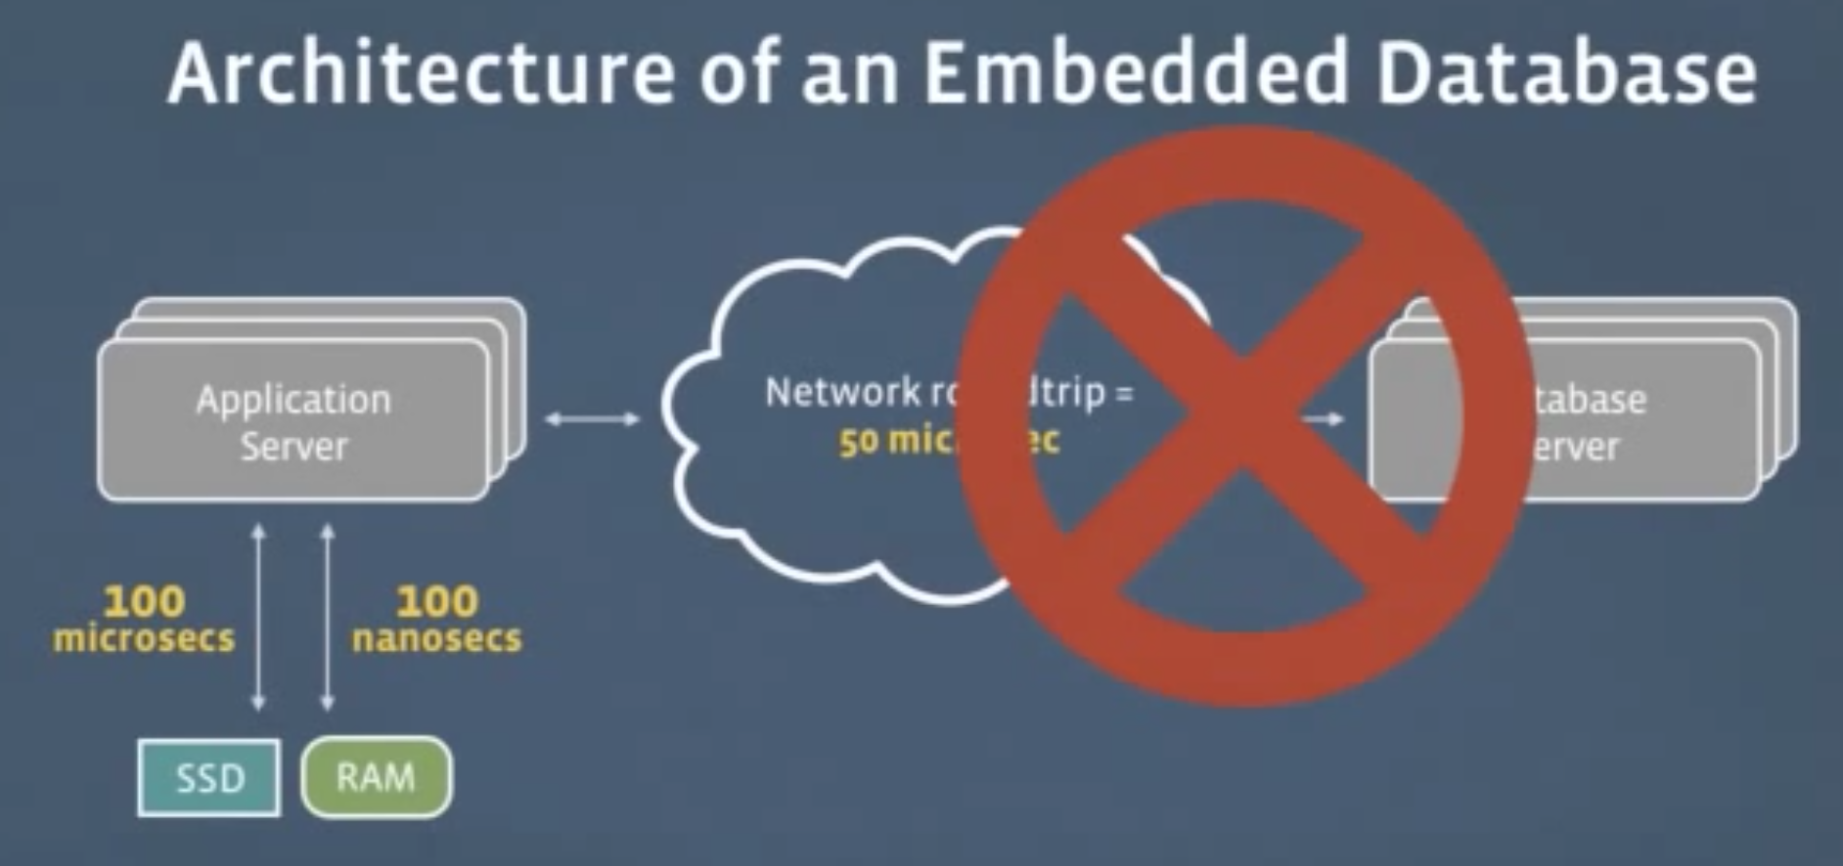
RocksDB Network Architecture
Notes:
To reduce latency RocksDB removes the SSD and RAM and moves it to the application server
Results in NO network latency

Slide 12
RocksDB Architecture
Written in C++ and provides official application programming interface (API) language bindings for C++, C, and Java
Near optimal read and scan performance Its merge scheduler bounds write latency without impacting throughput or allowing merges to block write for extended period of time
It does this by ensuring merges at each level of the tree without resorting to the techniques
RocksDB organizes all data in sorted order and the common operations are Get(key), Put(key), Delete(key) and NewIterator() [2].
Notes:
written in C++ and provides official application programming interface (API) language bindings for C++, C, and Java
Near optimal read and scan performance Its merge scheduler bounds write latency without impacting throughput or allowing merges to block write for extended period of time
It does this by ensuring merges at each level of the tree without resorting to the techniques
Get(key), Put(key), Delete(key) and NewIterator()
The Get API allows an application to fetch a single key-value from the database
An Iterator API allows an application to do a RangeScan on the database.
Put key does insertion or update’
While the delete closes a database
To Delete a database you use DestroyDB()

Slide 13
Basic Constructs
The three basic constructs of RocksDB are memtable, sstfile and logfile.
The Memtable is an in-memory data structure - new writes are inserted into the memtable and are optionally written to the logfile.
The logfile is a sequentially-written file on storage.
Sstfile or SSTable is a Sorted Static Table on storage.
It contains a set of arbitrary, sorted key-value pairs and the entire database is stored in sstfiles.
It is organized in levels and is immutable.
Sorted data facilitates easy lookup of keys [2].
Notes:
Abhisha

Slide 14
Implementation
Data Structures used:
Skiplist - allows fast search with in an ordered sequence of elements. Fast search is made possible by maintaining a linked hierarchy of sub sequences each skipping over a few elements.
Cuckoo Hash Table - helps resolve hash collision of values of hash function in a table with worst case constant look-up time.
LSM tree - disk based data structure designed to provide low cost indexing for a file experiencing high rate of records input and deletes over an extended period of time.
Notes:
Client - Server Architecture

Slide 15
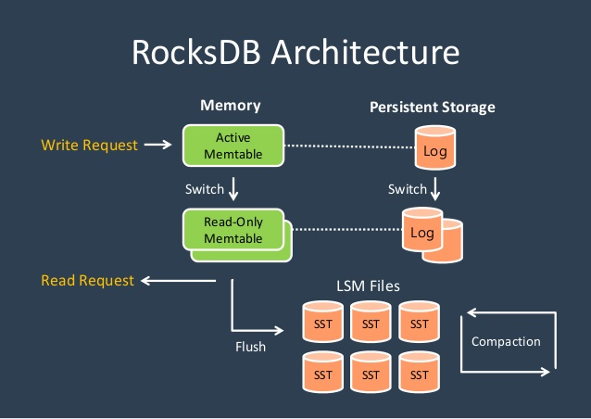
Notes:
Abhisha

Slide 16
Log structured merge tree
Log-structured merge-tree (or LSM tree) is a data structure with performance characteristics that make it attractive for providing indexed access to files with high insert volume.
Whenever a Put() operation is performed, the data is added to the in-memory mem-table, implemented as a skiplist having O(log n) inserts and searches.
The data is also appended to a Write Ahead Log (WAL) for recovery purposes [5].
Notes:
Abhisha

Slide 17
Log structured merge tree
After a write, if the size of the memtable reaches a predetermined size, then the following occur
The current WAL and memtable become immutable, and a new WAL and mem-table are allocated for capturing subsequent writes,
The contents of the memtable are flushed out to a SST data file.
Once flushing of memtable is completed the WAL and mem-table containing the data just flushed are discarded.
When Get() operation is performed, the memtable is searched first, then the newest SSTable/file, then the next SSTable/file and so on until the key is found or there are no more files to search.[10]
Notes:
Abhisha
For updates to existing keys the same process is followed. Rocksdb stores all the copies of the the updated keys

Slide 18
Compaction
Since updates are also appended Rocksdb ends up with multiple copies of the same key.
To prevent the database from growing infinitely Rocksdb runs a background thread that periodically compacts the data: merging the SSTables to a bigger SSTable.
During the process duplicate keys are removed and clients may define their own “compaction filter” to filter out the unwanted key/value pairs as needed.
Parallel compaction on different parts of the data can happen simultaneously.
Deletions are also processed during compaction [10].
Notes:
Abhisha

Slide 19
RocksDB Data Compression
RocksDB currently supports several compression algorithms[8]:
LZ
Snappy
Zlib
Zstandard
Each level can be configured to use any or none of these compression algorithms.
Compression is applied on a per-block basis.
In each SST file, data blocks and index blocks can be compressed individually. Users can specify what compression types to use.
To reduce the frequency of having to uncompress data blocks, the RocksDB block cache stores blocks in uncompressed form.

Slide 20
RocksDB Block Cache
Block cache is where RocksDB caches data in memory for reads.
The block cache stores uncompressed blocks.
Optionally applications using RocksDB can set a second block cache storing compressed blocks.
Reads will fetch data blocks first from uncompressed block cache, then compressed block cache.
If the data block is not found in block cache, RocksDB reads it from file using buffered IO. Thus, RocksDB's cache is two-tiered: block cache and page cache.
There are two cache implementations in RocksDB: LRUCache and ClockCache
Notes:
To reduce the frequency of having to uncompress data blocks, the RocksDB block cache stores blocks in uncompressed form. (Note that recently accessed compressed file blocks will be cached by the operating system page cache in compressed form, so compressed SSTs will use less storage space and less cache space, which in turn allows the file system cache to cache more data.)

Slide 21
What RocksDB is NOT
Not distributed
Does not do any replication, other mechanisms for replication are in other components of Facebook.[7]
Basically a simple single code API, C++ application that fast writes and reads.
LevelDB and RocksDB are not distributed databases. Hence, CAP Theorem is inapplicable.

Slide 22
Using RocksDB
RocksDB can be used in many ways:
Just RocksDB - Download and install RocksDB. Perform CRUD operations using its libraries.
MyRocks is RocksDB integrated as a MySQL storage engine. With MyRocks, we can use RocksDB as backend storage and still benefit from all the features of MySQL.
PyRocks - Python bindings to the C++ interface of RocksDB using cython
MongoRocks is the RocksDB based storage engine for MongoDB.

Slide 23
Applications of RocksDB
Basically for data storage
Specifically, at Facebook, it is used as storage engine for Laser, a high query throughput, low latency key-value storage service
RocksDB can be used by applications that need low-latency database accesses. Some examples include:
A user-facing application that stores the viewing history and state of users of a website.
A spam-detection application that needs fast access.
A graph-search query that needs to scan a data set in real time.
An app that needs to query Hadoop in real time.
A message-queue that supports a high number of inserts and deletes.
Notes:
Aside normal data storage
How does RocksDB store facebook chats etc.

Slide 24
References
[1] Wikipedia. “RocksDB.” Wikipedia, Wikimedia Foundation, 13 Feb. 2018, en.wikipedia.org/wiki/RocksDB.
[2]Borthakur, Dhruba, and et al. “Facebook/Rocksdb.” GitHub, 19 Dec. 2017, github.com/facebook/rocksdb/wiki/RocksDB-Basics.
[3] meeeejin. “RocksDB detail.” LinkedIn SlideShare, 7 Nov. 2016, www.slideshare.net/meeeejin/rocksdb-detail.
[4] Canadi, Igor. “Spatial indexing in RocksDB.” RocksDB, 17 July 2015, rocksdb.org/blog/2015/07/17/spatial-indexing-in-rocksdb.html.
[5] “Log-Structured merge-Tree.” Wikipedia, Wikimedia Foundation, 13 Feb. 2018, en.wikipedia.org/wiki/Log-structured_merge-tree.
[6] “Skip list.” Wikipedia, Wikimedia Foundation, 10 Feb. 2018, en.wikipedia.org/wiki/Skip_list.
[7] “FAQ.” RocksDB, rocksdb.org/docs/support/faq.html.
[8] Siying Dong, Mark Callaghan, Leonidas Galanis, Dhruba Borthakur, Tony Savor, Michael Strum:
Optimizing Space Amplification in RocksDB. CIDR 2017
[9] Kai Ren, Qing Zheng, Joy Arulraj, Garth Gibson:
SlimDB: A Space-Efficient Key-Value Storage Engine For Semi-Sorted Data. PVLDB 10(13): 2037-2048 (2017)
[10] Liu, K. (2014, February 12). How To Sound Like You Know RocksDB (1) – RocksDB for everyone – Medium. Retrieved February 16, 2018, from https://medium.com/rocksdb-internals-a-beginners-guide/how-to-sound-like-you-know-rocksdb-1-a194db9e5070
[11] http://pyrocksdb.readthedocs.io/en/v0.4/
[12]https://www.youtube.com/watch?v=hHsxqkcZy7c

